Slide 1


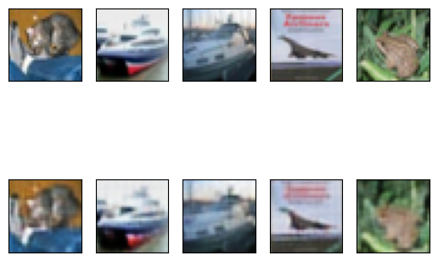


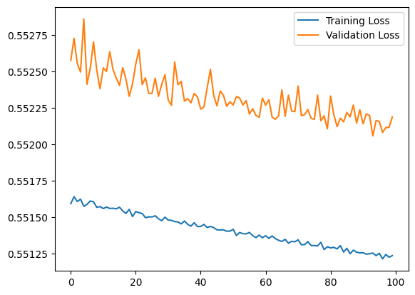


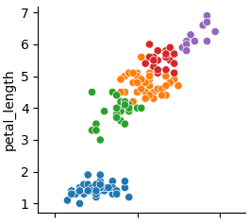




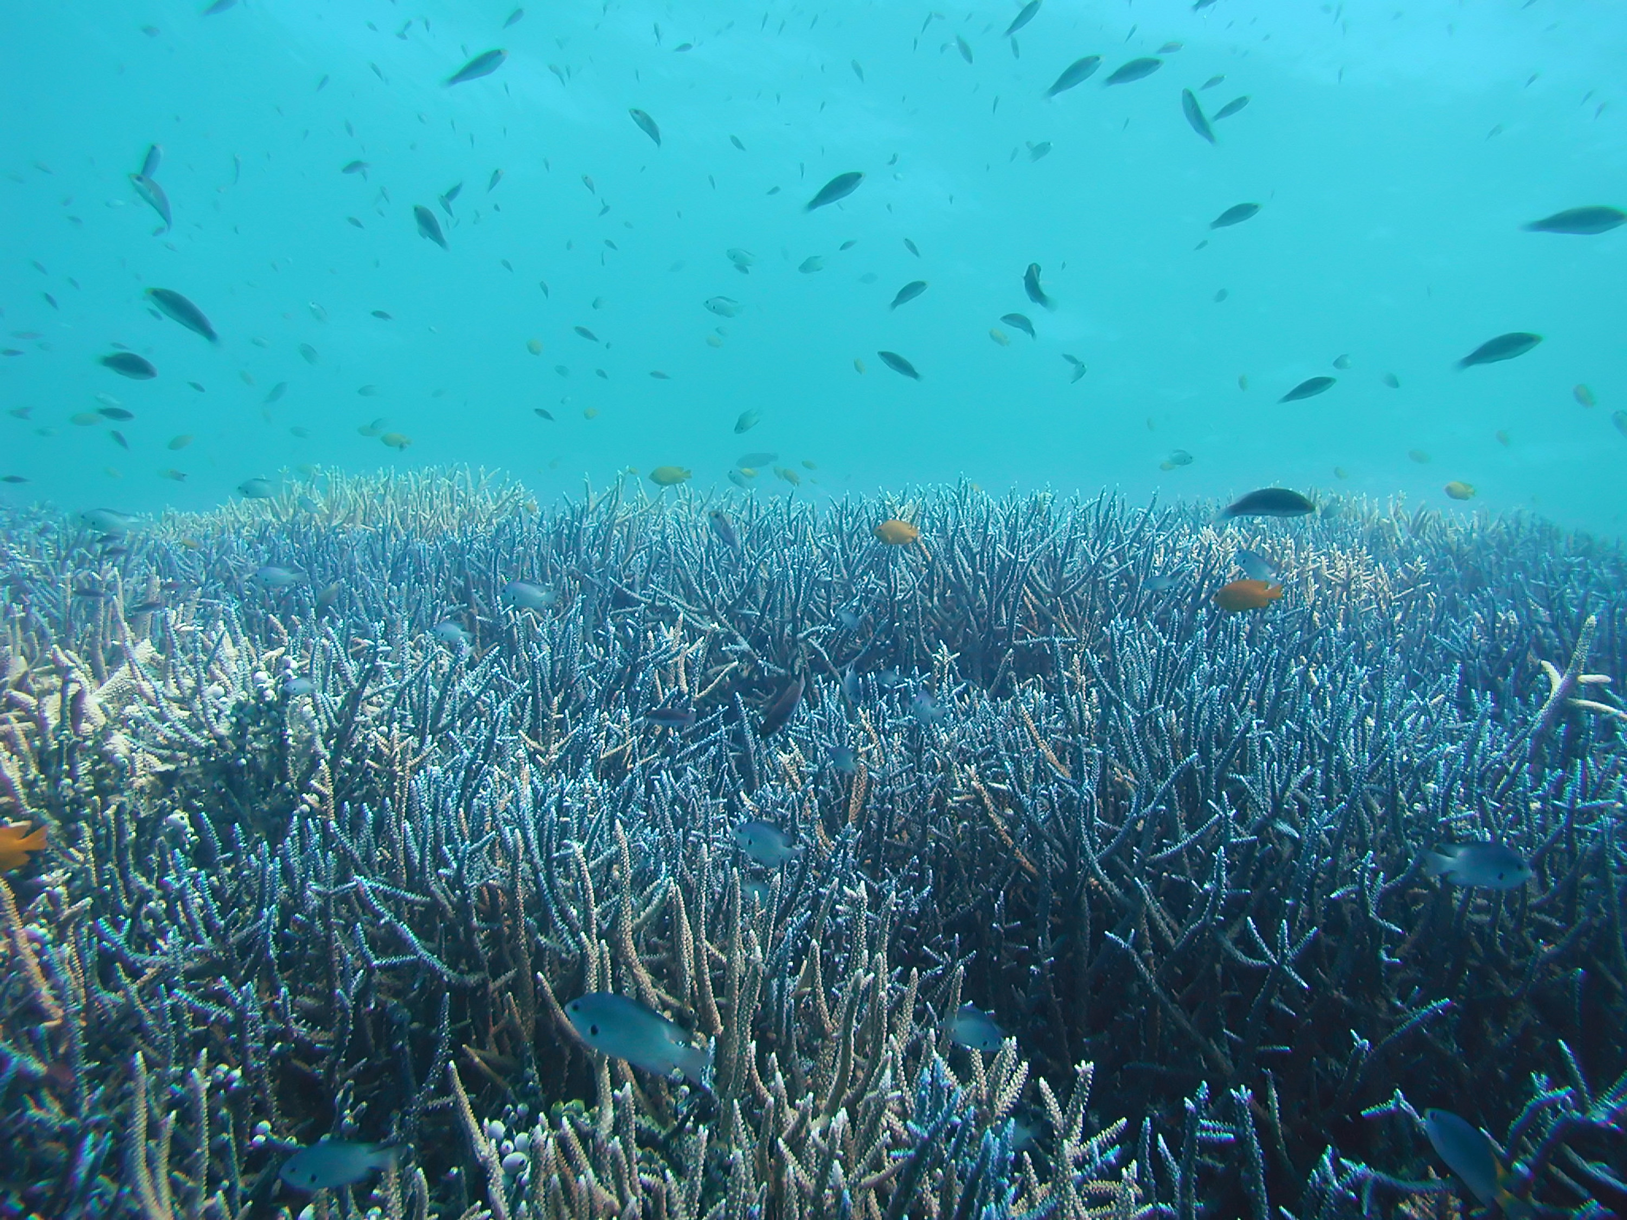

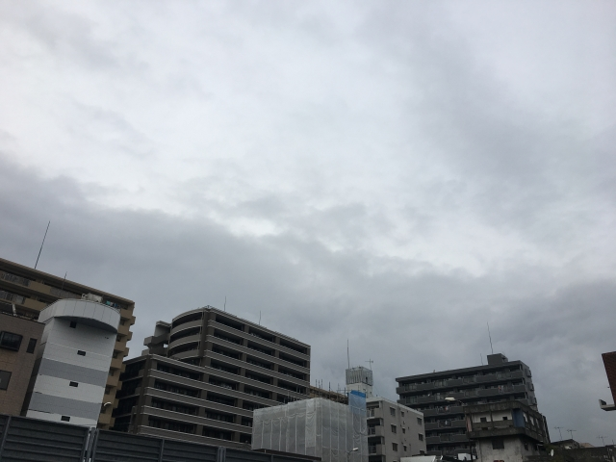
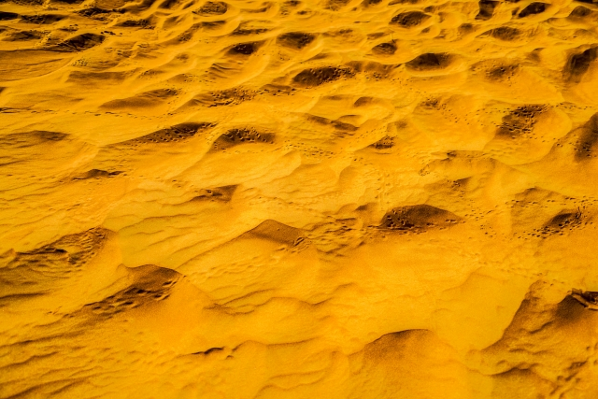
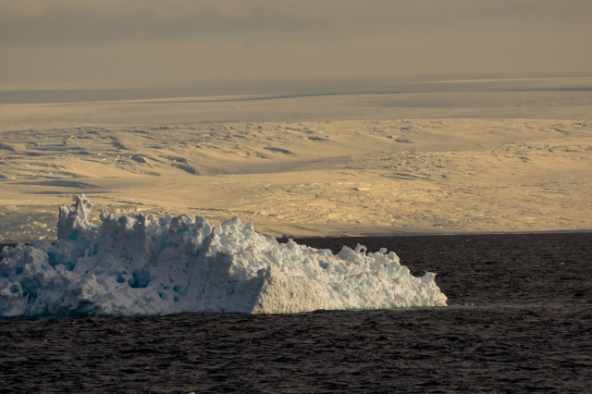
Autoencoder-based Feature Extraction for Scene Search in Live Nature Camera
Yukito SEO^{1,*}, Rafly Arief KANZA², Kosuke TAKANO³
Course of Information Technology, Kanagawa Institute of Technology
Politeknik Elektronika Negeri Surabaya
Department of Information and Computer Sciences,Faculty of Information, Kanagawa Institute of Technology
*corresponding author: s2021065@cco.kanagawa-it.ac.jp
Introduction
Research process
The importance of earth observation is world widely increasing due to the effect of global climate change and so on. In order to protect the global environment, it would be useful to offer archives of video data of monitoring natural environment in as many spots as possible.
To provide such a facility, construction of monitoring environment with live nature cameras is very significant.
In this study, we propose a method for extracting and indexing image feature vectors to reduce the computational cost of image retrieval using an autoencoder model.
Image generation by autoencoder
Dataset : cifar10 (Learning Multiple Layers of Features from Tiny Images, Alex Krizhevsky, 2009.)
Image size : 32×32, RGB
Original images
Generate by autoencoder
Proposed method
Generated images
Step-1
An autoencoder model is trained with a set of nature images such as landscape, animals, and plants.
Result
The image produced by the autoencoder was blurry.
The error between the validation data and the training data was about 0.001.
Encoder
decoder
Images
Compressed
Feature vector
Generated images
Step-2
Image data from live nature camera is sent to the trained autoencoder model in Step-1, and the feature vector is extracted.
Next work
Implementing algorithms to classify feature vectors.
Investigate the relationship between the error between the validation data and training data and the extracted feature vector.
Encoder
・・・
Images from live nature camera
Compressed Feature vectors
Conclusion and future work
Step-3
The feature vectors extracted in Step-2 are classified based on the vector similarities.
Currently, we are implementing the prototype of monitoring natural environment. We will evaluate the feasibility and effectiveness of the proposed system in our future work.
Step-4
A representative feature vector such as centroid vector is extracted in each cluster.
・・・
Compressed Feature vectors
Clustering
Indexing feature vectors
by representative vectors
Scene search server
(Ubuntu22.04)
Raspberry Pi
Step-5
Each representative feature vector is indexed for the image search.
Building a server with Flask
Feature extraction by autoencoder
Implementation of similarity calculation algorithm
Indexing by representative feature vectors
Evaluation of the feasibility and effectiveness of the proposed system
Cluster_1 | Cluster_2 | Cluster_3 | Cluster_4 | Cluster_5
Data1_1 | Data2_1 | Data3_1 | Data4_1 | Data5_1
Data1_2 | Data2_2 | Data3_2 | Data4_2 | Data5_2
Data1_3 | Data2_3 | Data3_3 | Data4_3 | Data5_3
Indexing feature vectors
by representative vectors
: Indexing feature vector
Programs (Python)
In the image retrieval process, for an input query image, first, the similarity scores between the feature vector of query image and the indexed representative vectors are calculated, and the top-n image clusters based on the similarity scores are selected. Then, images in the selected clusters are shown as the image retrieval results.
In addition, we are facing many environmental changes such as destruction of coral reefs, progress of desertification, sea level rises due to ice melting in the pole area.
Our scene search system will contribute to allow us to share such critical information by the fast scene search capability.
Encoder
feature vector
Input image
Similarity calculation
Destruction of coral reefs
Abnomal weather
Top 3
Cluster_1
Cluster_3
Cluster_5
Cluster_1 | Cluster_2 | Cluster_3 | Cluster_4 | Cluster_5
Data1_1 | Data2_1 | Data3_1 | Data4_1 | Data5_1
Data1_2 | Data2_2 | Data3_2 | Data4_2 | Data5_2
Data1_3 | Data2_3 | Data3_3 | Data4_3 | Data5_3
Output image
Desertification
Sea level rise due to ice melting

